Slide 1
How to Build Inclusive Data Experiences (Advice and reflection for open-source communities) Frank Elavsky, Carnegie Mellon University and Fizz Studio

Slide 2
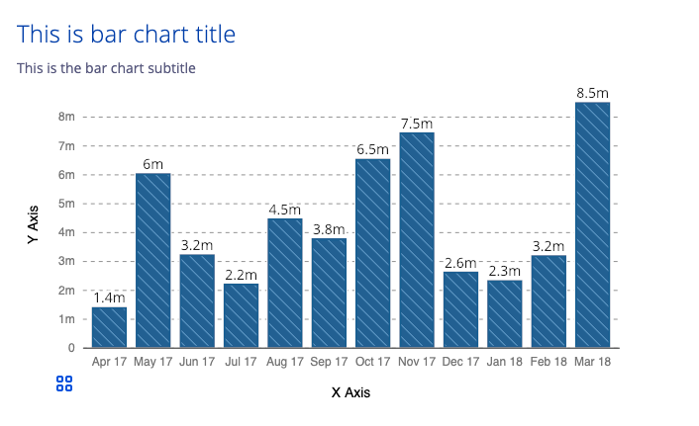
What do I do?
I am researching data interaction and accessibility at Carnegie Mellon.
I organize DataVizA11y and do industry consultations in partnership with Fizz Studio.
I was previously a Staff Data Experience Engineer on Visa’s DX Team.
I authored Chartability, a community-driven effort to establish heuristics for evaluating the accessibility of data experiences.
www.github.com/visa/visa-chart-components

Slide 3
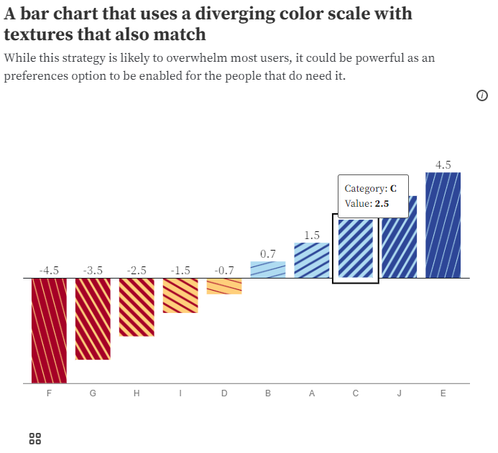
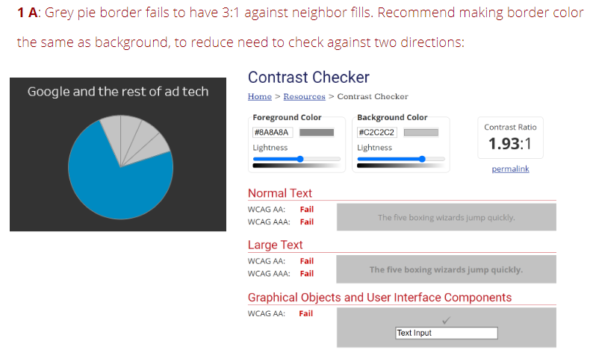
My Passion: Accessible data experiences

Slide 4
Before we begin.
If you post screenshots of this talk or slides around on Twitter or wherever (and please do), remember:
Add alt text to your post!

Slide 5
What is Accessibility (a11y)?
The qualities that make an experience open or usable to all.
The knowledge and skills to break down barriers specifically for people with disabilities.

Slide 6
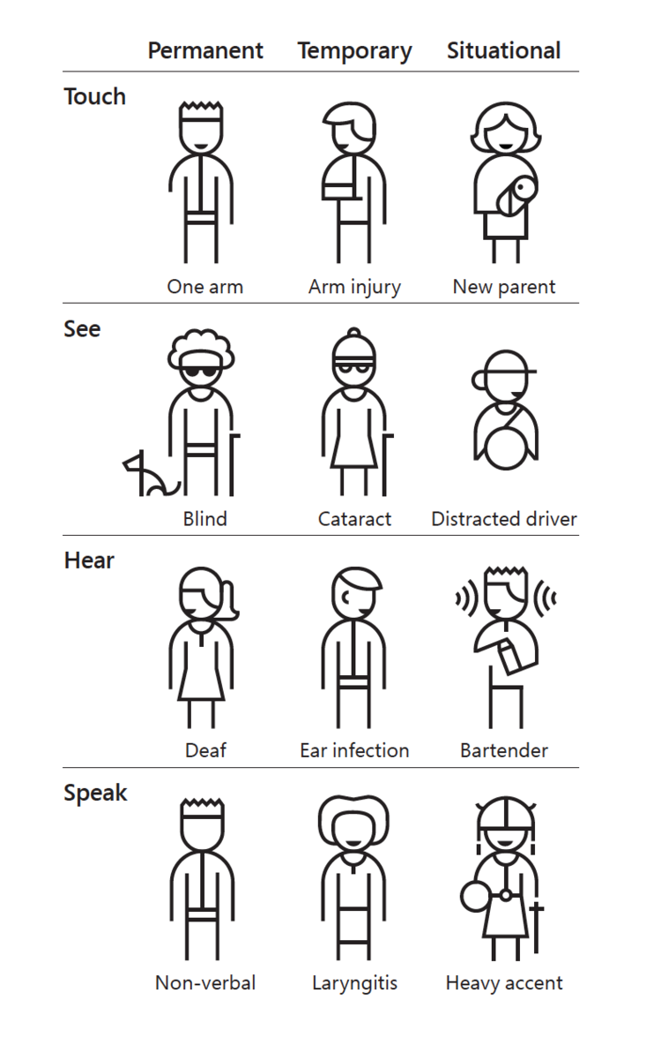
Accessibility is multi-dimensional
Some disabilities are permanent. Others are temporary or situational.
Source: https://www.microsoft.com/design

Slide 7
We have all already experienced a disabling limitation at some point in our lives – even if just temporarily or situationally.

Slide 8
Accessibility is personal for all of us.

Slide 9
And in tension: The specific barriers that people who live with disabilities face cannot be substituted by our experiences.

Slide 10
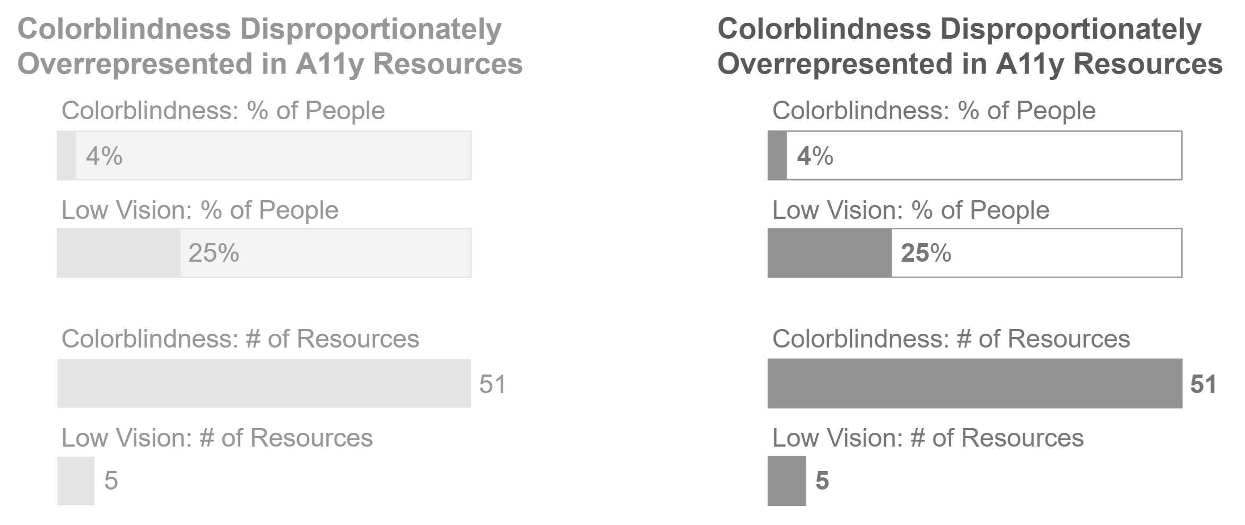
Uncorrected or uncorrectable moderate-severe visual impairment (“low vision”) affects ~28% of people globally

Slide 11
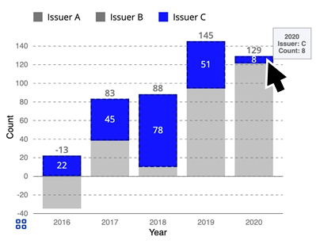
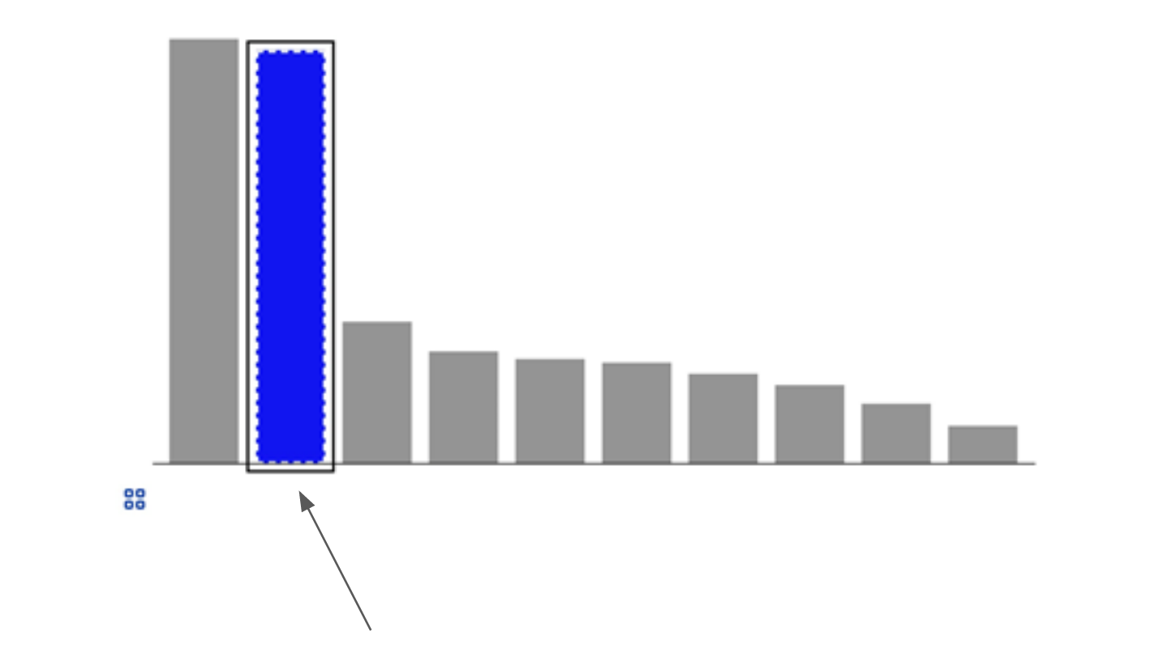
Motor impairment and functional disability (13-15%)

Slide 12
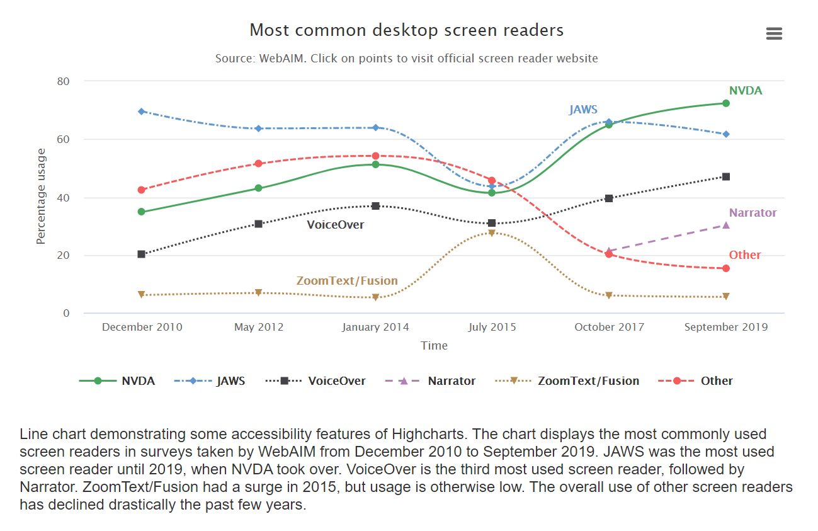
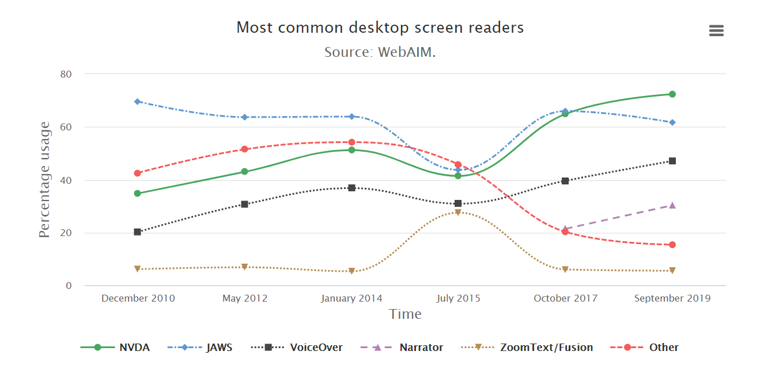
Cognitive and attention impairment (11-13%)
Source: Highcharts example (an accessibility-focused charting library).

Slide 13
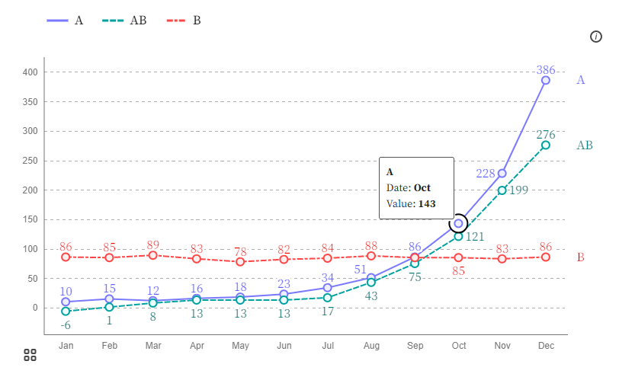
What is Data Visualization?
Data Visualization (also sometimes abbreviated as dataviz or datavis) is presenting data in a structured, symbolic way.
The structure and semantics go beyond the visual however, so we prefer to call these data experiences or representations.

Slide 14
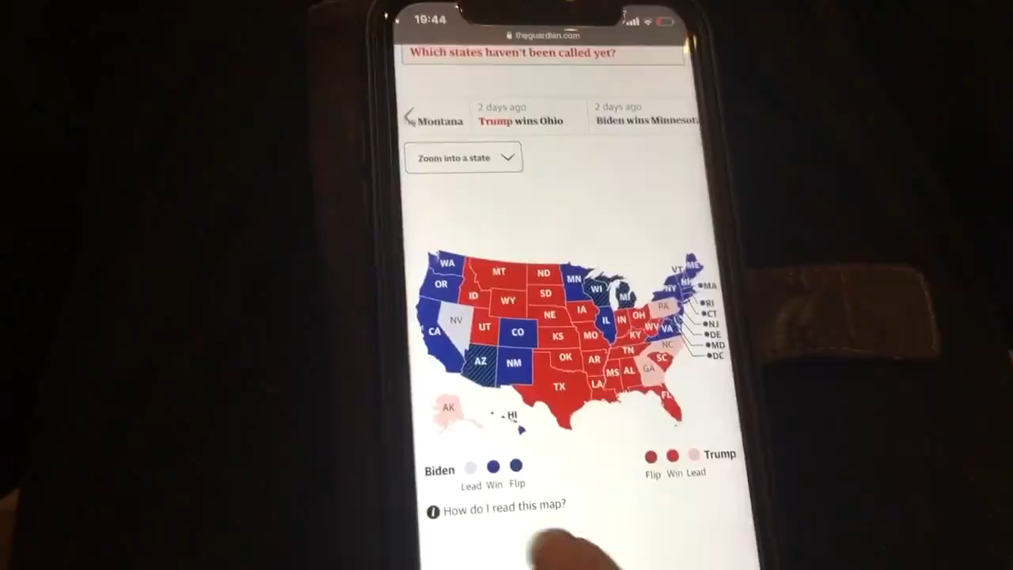
Data is painful. Visualization shouldn’t be.
Sarah’s video on Twitter

Slide 15
Why am I talking about data visualization and not other data stuff (like notebooks)?

Slide 16
visualization is already an assistive technology
Taking data (something hard to understand) and turning it into a representation or experience that is easier to understand is an assistive act.

Slide 17
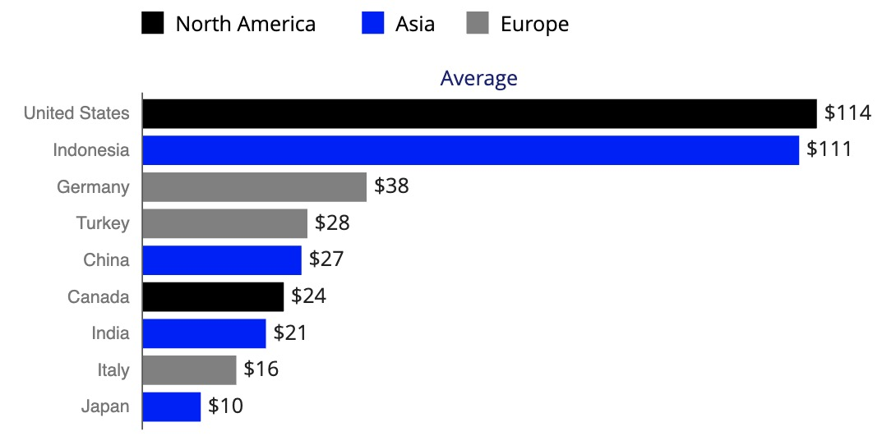
Data visualization is a hopeful starting point
Taking data and making it into a chart helps break down cognitive barriers. And if our primary motivation is to break down barriers for understanding data, why not keep going?
Region | Country | Value
North America | United States | $114
Asia | Indonesia | $111
Europe | Germany | $38
Europe | Turkey | $28
Asia | China | $27
… | … | …

Slide 18
Data Representation and Data experiences
Visualization is how we talk about just one part of the picture.
Other design that plays a role in visualization:
Functional
Semantic
Structural
Interactive
And those areas have huge potential for continuing the work of assistive technology.

Slide 19
How can we make open-source data work more accessible?
Let’s discuss!
Suggest something in chat in 1 - 2 sentences. (Intentionally short! That is the exercise.)

Slide 20
What are the 10 best strategies on the Quest for Accessibility?
Individual:
Learn how to evaluate
Listen to people with disabilities
Pace yourself
Look for small wins
Structural:
Plan
Implement
Test
Review
Maintain
Celebrate

Slide 21
Not all action is Solved by individuals Alone.
A huge part of open-source work (as well as volunteer work more broadly) is that it is driven by community involvement and can be defeated by structural forces.

Slide 22
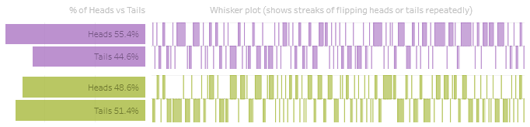
Study standards, Principles, and Guidelines
Individual:
Learn how to evaluate
Listen to people with disabilities
Pace yourself
Look for small wins
Grey text fails. 1.81:1
Purple text fails. 2.47:1
Purple geometry (no border) fails. 2.63:1
Green geometry (with border) fails. 1.98:1
Green text fails. 2.59:1
Example chart audited using WCAG 2.1 contrast standards and Chartability.

Slide 23
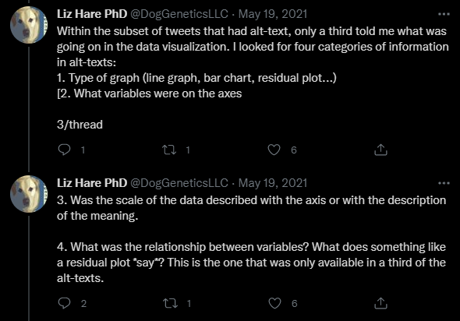
Invite people *and* find where they are already speaking
Individual:
Learn how to evaluate
Listen to people with disabilities
Pace yourself
Look for small wins
Liz has been an amazing partner and teacher and is really involved on Twitter!

Slide 24
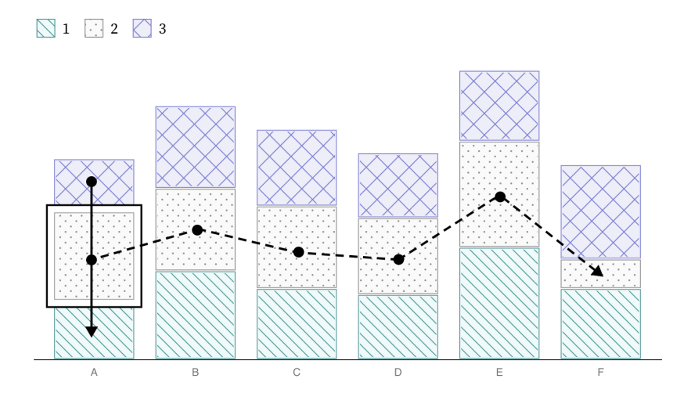
Work on 1 new skill at a time
Individual:
Learn how to evaluate
Listen to people with disabilities
Pace yourself
Look for small wins
My current deep dive has been interaction paradigms for keyboard and touch access. I’m still learning and studying!

Slide 25

Break issues into smaller, manageable parts
Individual:
Learn how to evaluate
Listen to people with disabilities
Pace yourself
Look for small wins
The Task Force on Gay Liberation worked to reclassify homosexuality as a variety of sexual life. Just one piece of the larger battle and a lesson that Community Organizing can teach us. (Photo of the great Barbara Gittings, by Kay Tobin Lahusen and licensed under CC BY-SA 3.0)

Slide 26
What are the 6 best Structural strategies for Accessibility?
Structural:
Plan
Implement
Test
Review
Maintain
Celebrate
Governance and management can be a huge help in open source efforts for accessibility.
If you are struggling to organize the results of an audit, you may want to consider breaking each finding into the most atomic, manageable pieces and then plan your milestones and priorities.

Slide 27
How do we know whether something is inaccessible?
Evaluation!
The practice of evaluating something according to a consistent system of tests and standards is called an audit.
Anyone can learn how to audit! Designers, engineers, managers, analysts, scientists… really, anyone.

Slide 28
So, how do you learn how to evaluate?
Ideally: Look to standards.

Slide 29
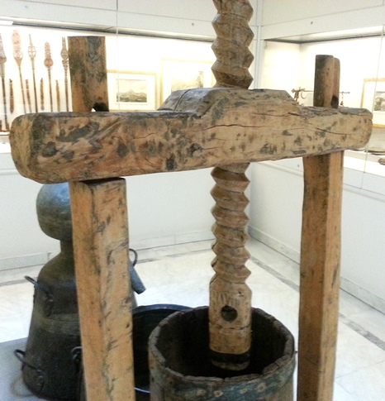
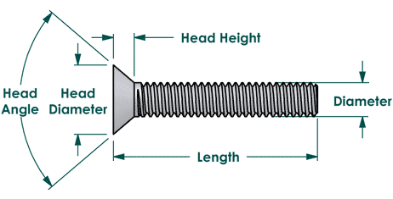
Why standards?
Industrial standards are what separates any given hex code from a Pantone color or a wood fastener from a Philips screw.

Slide 30
The State of a11y Standards: WCAG
Web Content Accessibility Guidelines (or WCAG) is currently adopted in policy in some form or another by governments for 55% of the world’s population.
It is the biggest and best set of standards out there.
WCAG homepage and WCAG policy adoption internationally

Slide 31
Using Standards for evaluation only goes so far!
The next step is hugely important: involve folks with disabilities!

Slide 32
5 Ways to make your Collaborators’ lives easier
Invite them to discussions

Slide 33
5 Ways to make your Collaborators’ lives easier
Find their communities and join them

Slide 34
5 Ways to make your Collaborators’ lives easier
Write up issues on your repo with them or for them once you catch something together
(Don’t just ask them to go and open an issue, be proactive!)

Slide 35
5 Ways to make your Collaborators’ lives easier
Empower them to help drive design decisions that affect them.
(And don’t just use them for testing! This can feel one-sided.)

Slide 36
5 Ways to make your Collaborators’ lives easier
If you’re going to pay anyone in this whole process, pay them for their expertise.
(People with disabilities are often asked to do work for free.)

Slide 37
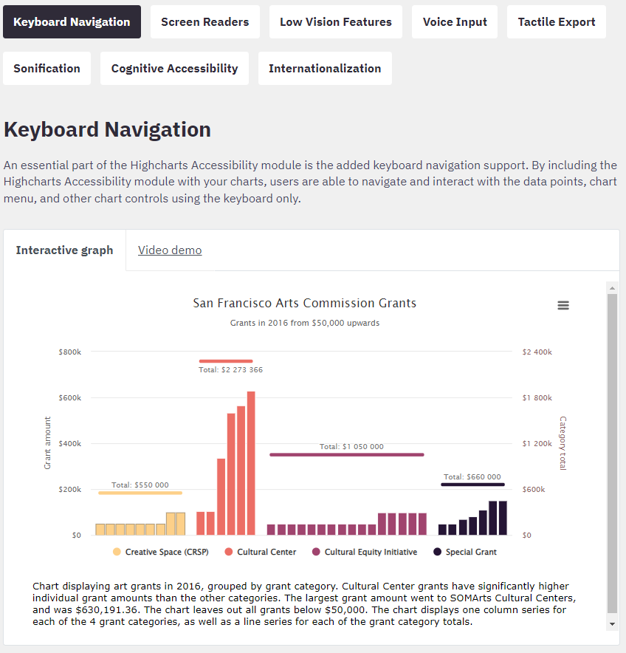
Final Advice: “Using what we already have”
This is design advice from assistive tech + DIY spaces: using existing materials and technology to solve access problems. Can we repurpose or reconfigure?
(Highcharts and Visa Chart Components both have really robust accessibility options, for example.)
Look at all those considerations that Highcharts has engineered and designed for! What can we learn and use from this?

Slide 38
resources:
Follow me on twitter for news about my work (@FrankElavsky).
About the group I am a part of: github.com/dataviza11y/Why-We-Exist
Our Group’s resources for visualization and accessibility.
Highcharts Accessibility: https://www.highcharts.com/blog/accessibility/
Visa Chart Components: https://developer.visa.com/pages/chart-components
Chartability Workbook: fizz.studio/files/chartability-worksheet
Chartability Slides: fizz.studio/files/chartability-deck
Chartability Website: chartability.fizz.studio/

Slide 39
THANKS
Get in touch at:
@FrankElavsky on Twitter
fje@cmu.edu

